Slide 1
“ When I first became an industry manager I used to question if the agencies I used to find me staff might actually be causing my recruitment problems.
Sadly, it did not take me long to discover that many were doing just that, by headhunting my existing staff from my departments, contacting staff they had already placed with me, while also then calling me to see if I needed new staff.
I found this very frustrating.
When I launched Motor Industry Recruitment I decided to put a stop to these types of activities”
The non Predatory Recruitment Consultancy
Recruitment Consultancy of the Year 2011
as voted for by the readers of Car Dealer Magazine
(Please click your mouse or use your forward arrow key to continue)
Richard Gosling. MD

Slide 2
The non Predatory Recruitment Consultancy
Recruitment Consultancy of the Year 2011
as voted for by the readers of Car Dealer Magazine
Motor Industry Recruitment have been finding good people for the industry since it was formed in 1999 and directly involved in motor industry recruitment for 30 years
We have been responsible for placing 100’s good candidates so feel well
equipped to know the profile of candidates who adapt well to the demands
our industry and your customers place upon them
For speed and efficiency we have specialist recruitment software able to
pin point candidates who have the specific industry skill sets you need within
a given distance of your operations

Slide 3
The non Predatory Recruitment Consultancy
We NEVER Headhunt to “find” new candidates
(some call this offering a Search and Selection “service”)
Look here http://viewer.zmags.com/publication/251a53a3#/251a53a3/66
for the only Agency NOT offering to Search and Select
Headhunting can be perceived as helping. We see headhunting as causing another client their recruitment problem
The “Search and Selection” activities of our competitors could possibly be the reason you need to find new staff
Also, we NEVER contact a placed candidate. Many claim this but we know
they struggle to stay the correct side of that ethical line
Prior to our candidates accepting a position we inform them that we will not
be able assist them to leave the employer we are about to place them with

Slide 4
We only present our candidates details to our clients if they are fully aware of:
The non Predatory Recruitment Consultancy
Exactly who the employer is
Where the position is based
What the actual basic and realistic OTE salary for the position is
The job title, expected performance levels and responsibilities
We have an up to date CV
Where possible, we have gained references from previous employers
We are happy that our candidates skill set is a fit our clients requirements
And then send our clients our candidates actual CV and not a “Profile Sheet”
we have “produced”

Slide 5
The non Predatory Recruitment Consultancy
We have over 8.000 registered candidates. All have approached us to help them develop their careers; not for us to fragment it for our gain
We reject over 30% of candidate applications
We currently help many established dealer groups and manufacturers
such as Mercedes UK, Ford Retail, Inchcape, Johnson GP, Mitsubishi UK,
The Perry Gp, Squire Fernaux, as well as many others over the years
We offer industry competitive rates and candidate guarantees

Slide 6
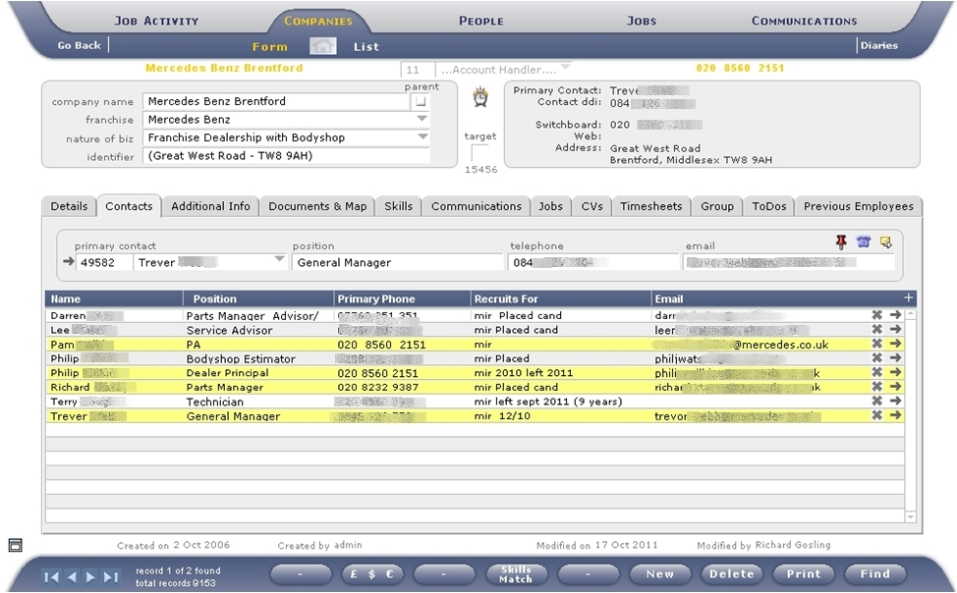
Our specialist software: The client profile page
The non Predatory Recruitment Consultancy
Here you can see client contacts (yellow)
and the candidates who are registered with us or we have placed within this operation (white).
You will see notes:
“placed” by the candidates we have placed within this particular dealership.

Slide 7
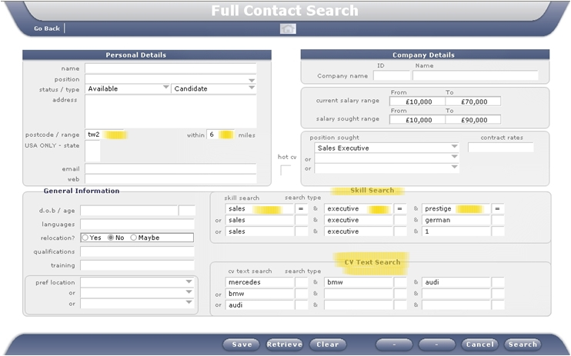
Candidate Search :
The non Predatory Recruitment Consultancy
This is a first stage search
It shows we are looking for Candidates who live within 6 miles of the postcode of the dealership and who have the skill set the client has requested we look for.
Note: Bottom Right: We are also able to search for text within our candidates CV’s as well as the skills we have allocated to them following our assessment of the candidates.

Slide 8
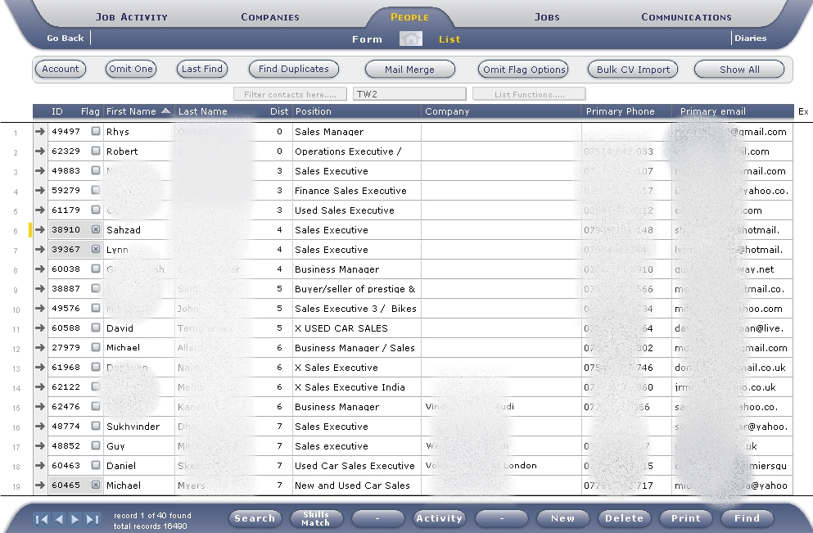
Search results ordered by distance from the dealership
The non Predatory Recruitment Consultancy
You will see that there
are Sales Managers and BM’s as well as Sales Executives within this search.
These more senior candidates are included because they have indicated to us when first applying that they are happy to take this level of position as a starting point for the right employer.

Slide 9
The non Predatory Recruitment Consultancy
Recruitment Consultancy of the Year 2011
We would be delighted to use the experience and expertise we have gained within our industry to help you and your business find, and keep, the best performing people it needs to deliver the standards your customers demand.
For a confidential chat about how we might be able to help
please feel free to call us on 0845 257 9224 or email
info@mirec.co.uk

